Slide 1

Deep Learning MSiA 490-30
Theory and Applications

Slide 2
Convectional Neural Network
Convectional Neural Network
Using Deep Learning to allow creative combination of ingredients and generate new recipes for people to experiment with
Group members
Lydia Chang
Stephanie Ger
Ik-Hwan Kim
Craig Ng

Slide 3
Problem Statement
Problem Statement
Creative combination of ingredients can be difficult for most people who lack cooking experience.
With help of machine learning (and a lot of data), a model can generate new recipes for them to experiment with.
Difficulty
Current machine learning models are effective at copying and regurgitating inputs.
Generating original output from those inputs can be bit more problematic.
Other approaches
Models have been trained on a very general set of recipes including multiple types of food (both savory and sweet recipes).
Some common ingredient like salt appears in recipes as varied as cakes, burgers and pizzas, confusing the model.
Models trained with both directions and ingredients adds to the complexity and the models focused on learning format rather than content.
Most previous models have utilized character-level generation, which is the most granular and difficult level of generation with regard to text.

Slide 4
Dataset
Yummly’s API (a recipe repository) provided 80,000 ingredient lists for the search parameter ‘cookie’.
Example Raw Data: ['2 cups flour', '1 teaspoon baking powder', '1 teaspoon baking soda', '1 teaspoon salt', '3/4 cup butter, room temperature', '3/4 cup brown sugar (packed)', '3/4 cup granulated sugar', '2 large eggs', u'2 teaspoons vanilla (or slightly more, to taste)', '3 1/2 cups old-fashioned oatmeal', '2 cups raisins (soaked in hot water flavored with vanilla, then drained)']
Cleaning the Data:
Removed any recipes that didn’t have cookie in the title
Removed special characters and converted from Unicode to ASCII
Created a dictionary of words by looking at the term frequency matrix of the corpus and removing any infrequent (<100) terms
Inspected the final dictionary and removed any words that were instructions or were unrelated to cookies
Removed any words not in the final dictionary from the corpus
Not much computation power was required to process the data (Local machines were sufficient to process the data)
Was the dataset big enough, do you think overfitting is likely?
Show loss curve during training to see how well the network has learned

Slide 5
Technical Approach
Preprocess the data
Prepended the title of the recipe to the beginning of the recipe (within brackets) and tab-separated it from the ingredient list, which is comma separated
Created synthetic data by shuffling the ingredient list for each recipe (while retaining the same title) to try and combat dependencies on ingredient order
Embedding Choice
Use phrase2vec with different levels of embedding:
character-level
word-level
phrase-level
For character-level, used a sentence of length 40 and a moving frame. For word- and phrase-level, used a sentence of length 50.
Model evaluation
Ran the code with each levels of the embedding for 100 epochs
Evaluate model success by looking at the novel recipes generated by the mode
Parameter Tuning
Compared GRU, LSTM, adjusted number of layers (2 or 3), adjusted hidden neurons (128, 256, 512), and considered bi-directional LSTM

Slide 6
Technical Approach 2
Recurrent Neural Network (RNN): connections between units form a direct cycle so that it can exhibit dynamic temporal behavior
Long short-term memory (LSTM) improves upon RNNs using memory cells that remember long-term values
Gated recurrent units’ (GRUs) performance is similar to LSTM but the model has fewer parameters, as they lack an output gate
Figure 1 Illustration of RNN Figure 2 LSTM vs GRU

Slide 7
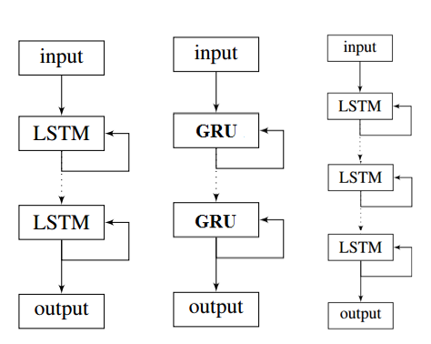
Technical Approach 3
Alternative Approach
Bidirectional RNN: connect two hidden layers of opposite directions to the same output, so the output layer can get information from both past (left context) and future (right context) states
Dynamic Convolutional NN: the connectivity pattern between its neurons is just like animal visual cortex. This network can be used to do sentence modeling.
Figure 3 The structures of our models

Slide 8
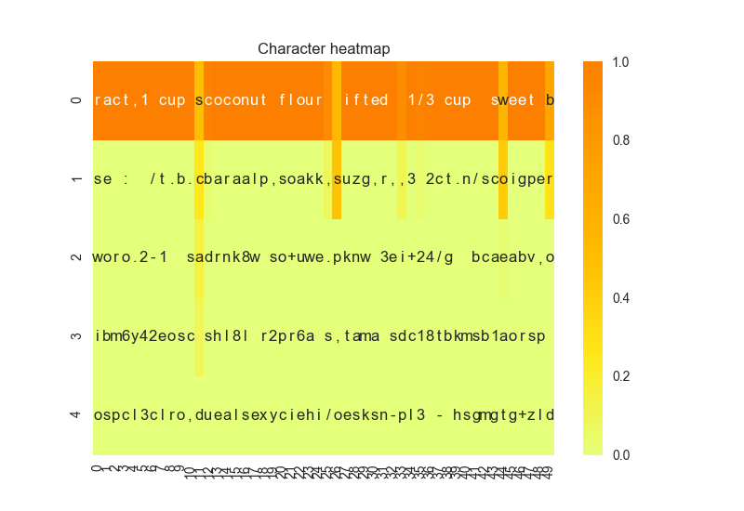
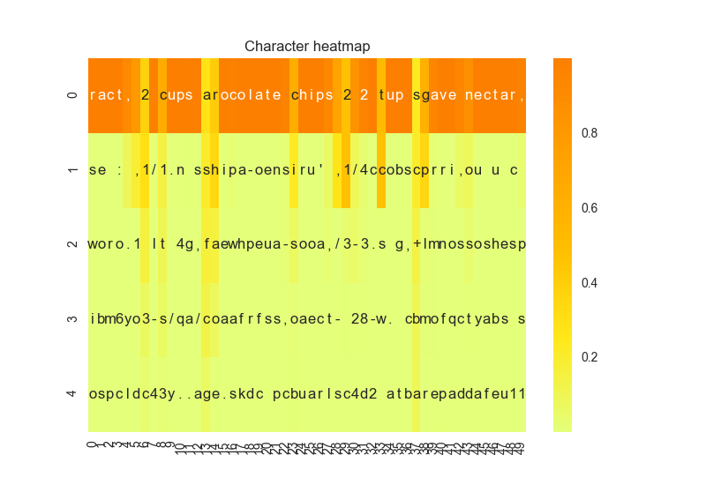
Results
Character level embedding with CNN
Heat map with diversity = 0.2
Heat map with diversity = 1.2

Slide 9
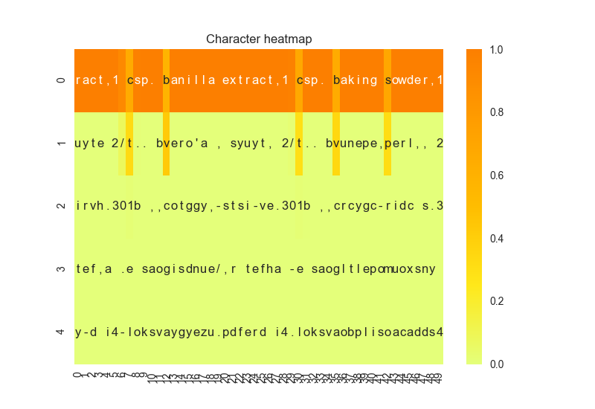
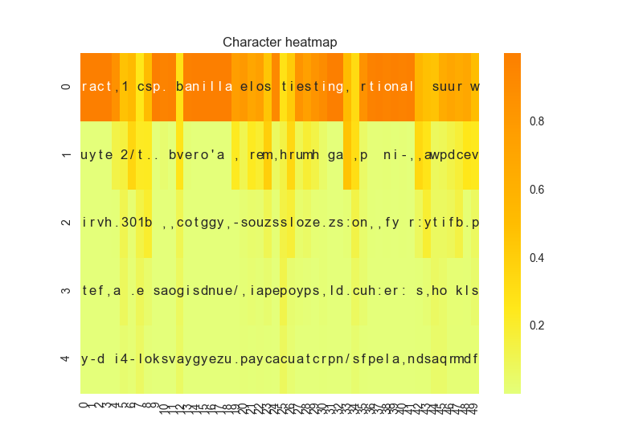
Results
Character level embedding with LSTM
Heat map with diversity = 0.2
Heat map with diversity = 1.2

Slide 10
Results 3
Why can we trust your model?
What are the strengths of the model?
Where does the model fall short?

Slide 11
Conclusion
Brief summary of what you discovered based on results
Difficult to produce legitimate recipes using character-level embedding
Word2vec provides the best balance between legibility and creativity
Limitations of approach
Dictionary limited to those words/recipes available via the Yummly API
How to improve/future work
Generalize to include other types of food (e.g., muffins, cakes), then use combination of words specific to each type to seed recipe generation
Train model to classify recipes based on ingredients
Include directions to give full recipes
Convert all fractions to decimals (e.g., ¾ to 0.75)

Slide 12
References
Do Androids Dream of Cooking? (Tom Brewe)
Keras LSTM Text Generation Example Code (François Chollet)
Word RNN Tensorflow Code (Sung Kim)
The Unreasonable Effectiveness of Recurrent Neural Networks (Andrej Karpathy)
Generating Text with Recurrent Neural Networks (Ilya Sutskever, James Martens, Geoffrey Hinton

